Slide 1
DevOps for
SAP Process Integration
2022

Slide 2
Agenda
Figaf
How to handle SAP PI/PO
Demo
Other changes
QA

Slide 3
Figaf
Works on creating tools to automate SAP Integration
For 6 years we have been creating products that simplified the way SAP Integration is delivered
It all started with a SAP PI testing tool. Then we found we could add even more services because it was easy to build and could improve the life of developers
Won SAP's Hack2Build in May 2021 to build a migration tool.

Slide 4
DevOps for SAP Process Integration

Slide 5
Does it make sense to continue to use SAP PI
SAP Cloud Integration is a nice platform for handling integrations
  We do provide a tool to automate the migration
Limitations
  A2A scenarios
  B2B flows
  Governance and reuse
  Separation of configuration and deployment
  Monitoring
  Exactly Once (In Order)
For clients with 500+ integrations the Cloud Integration is not ideal yet (but do start the migration for some scenarios)

Slide 6
Goals for the client project
Move governance away from sending Excel/Word documents for documenting changes required
Automate configuration of channels during transport
Switching sender/receivers of ICOs in batch during S/4 Migration
Projection of ICOs to limit number of Receiver and interfaces Rules
Rollback Directory transports
Automate Partner creations

Slide 7
All in one tool to simplify the process
All configurations is handled
All changes is registered in the system
Testing of the integration can be handled in the system
Approval with all context information

Slide 8
Landscapes to transport content
Only two systems connected
Gives more options for handling transports and setup
  Renaming systems in the mapping
  Can be on the same PI system which gives advanced options of copying integrations
Can be linked to form a Composite landscape, so transports are going to be connected in full landscape
Set up mapping of systems between agents
Substring value replacement of transport parameters (ie Backed hostnames)

Slide 9
Landscapes to transport content
Dev
QA
S4
PreProd
S4
Prod

Slide 10
Configuration of channels
Better view on channels to simplify the configuration process
See what has changed in a transport
The name of the attributes with documentation so you know what it is about
Filtering based on changes
Seach/replace hostnames from one system to another
Make approvals easier to see what has changed
Password change cannot be detected (Security)

Slide 11
Review/Approval
You can setup who can approve a given landscape
More revert back steps to simplify rework
Better ability to handle approvals
User cannot approve his own transports (configurable)

Slide 12
Tagging
Group items into business units or processes
Identify owners
Provide additional documentation for governance
Understand which applications are affected by a change
Is copied to transported objects

Slide 13
Rollback a transport
How do you undo a transport if you find something does not work
If you have configured something that does not work
Only possible if all objects are still the latest version on target system
Only Directory Changes updated via Webservice

Slide 14
Transport from one system to another
Create a ticket for making a change
Run Tests on the change
Create a transport
Configure it in production
Transport it to QA
Show documentation

Slide 15
Demo Time

Slide 16
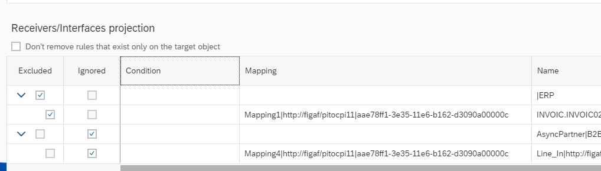
Transport only parts of an ICO
You may have some ICOs where you have a huge number of Receiver or Interfaces. Normally you cannot transport such cases and it is only possible to handle manually
With the new feature we can specify which to exclude or ignore
Part of the transport process

Slide 17
Transport configuration on the same system
Create transport
Rename Sending system
Transport ICO, Channel

Slide 18
Demo Time

Slide 19
Improved governance
Audit trail of all changes
Everything is connected to a change
Connection with Jira/Service Now
Testing of integration is delivered
Easier support because changes are highlighted

Slide 20
How is this different from ChaRM/CTS+?
CTS+ is good at handling transport and it integrates well with rest of SAP Landscape
Can be difficult to find what is changed in objects
Not possible to compare different versions of objects
You will still have to manually document what should be changed
After import there is a manual job with configuration

Slide 21
Run PI Partner creation API
Create a new set of SAP PI partners for an AS2 scenarios or other artifacts that could make sense to script
Create transport via Figaf Tool
Have approval from QA to Production
Separate application that can be customized to your need

Slide 22
Testing
Easy way of creating test cases
Make it faster to create test
Build EDI extractor tool to make large scale updates of all test cases
Run after changes and updates

Slide 23
What values will you see?
Simplify the deployment
Speed up development process
Lowers cost of deployments
Improves the governance
Remove the boring part of operations
Make you happier

Slide 24
DevOps with Figaf for Integration suite

Slide 25
Also support Integration Suite
DevOps for
  SAP Cloud Integration
  Api management
  Transport
  Testing
Migration for
  PI to CPI

Slide 26
DevOps with Figaf for SAP PI/PO

Slide 27
Business case
Time savings on transport
  Time savings pr transport performed 4-8 hours including testing, documentation and approvals
  Number of transports x Rate
  Example 10 transports x 6 hours x 70 EUR = 4.200 EUR x 12 months = 50.400 EUR/year
Other improvements
  Solve integrations faster
  Fewer errors and Faster resolution of errors
  Training time of employees/consultants
  Happier developers
Price starts at
  15.000 EUR/year

Slide 28
Implementation Plan
Meeting to understand how the tool can support your wish process
Trial evaluation tool on laptop or spare server
Installation on server
Configuration and setup of the landscape
Roll out of the tool
Time needed depends on your organization. We have seen times less than 1 month for productive use
But for PI use cases a few months will be expected

Slide 29
Schedule a call
Create a call with your and your team
Understand the business case Figaf can help you with
Get a plan on how you can optimize your processes
Figaf.com/book

Slide 30
Free trial of Figaf
30 day free trial
Get to see how to use the tool and follow some of our guides to get started depending on your roadmap
Experiment yourself or get our help to set it up with a 2 hour pre sales workshop
Figaf.com/devops

Slide 31
Q & A
or book your session at figaf.com/book

Slide 32
Try it out
figaf.com/devops

