Slide 1
Utilize DevOps to Optimize your SAP Cloud Integration

Slide 2
Agenda
The need for better processes
Figaf's take on DevOps
Testing integrations
Implementation plan
QA
© figaf 2022

Slide 3
DevOps for SAP Integration Suite
Cloud Integration

Slide 4
What is your biggest challenge with Integration Suite
Implementing a DevOps process
Process is not designed for developer productivity
Onboarding of new developers
Monitoring your integrations
Understanding when to migrate from PI to CPI

Slide 5
Your specialists’ time is valuable
Great SAP Integration Developers are worth Gold
Great Integration Architects are worth Platinum
What do they spend time on?

Slide 6
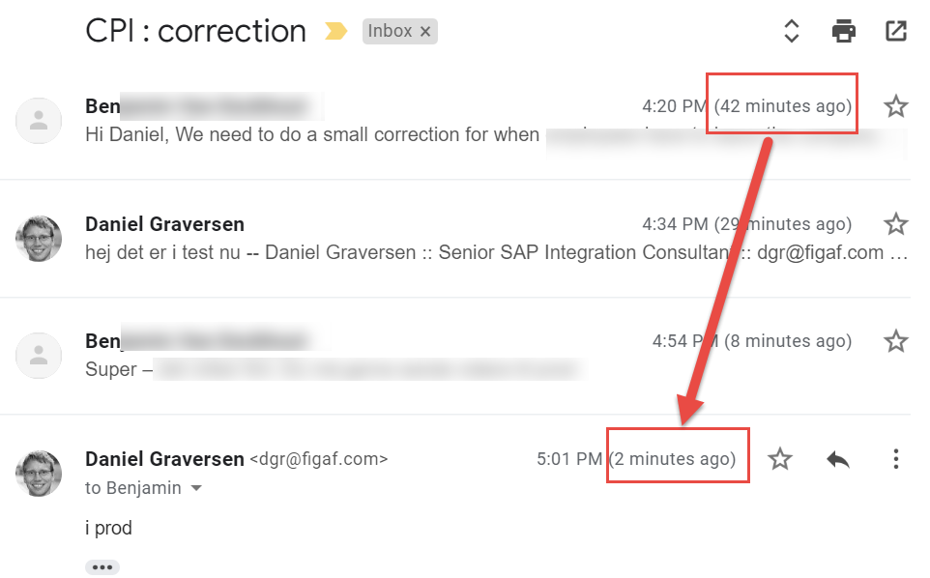
A transport can be fast
My Record is 40 minutes from a change request to deployment in production but
No documentation
No review
No testing
But that is not really how we should be delivering a integration

Slide 7
Need for better process
Integration Suite is not a toy anymore
File import/export is not good practice
Not a serious platform to handle your integration
Governance is important to the process
You cannot move random things into place
Testing should be possible for developers
They cannot rely on the business experts to run tests

Slide 8
Challenges with DevOps
Two places to develop Git repository/IDE and WebIDE to work on BPMN model
Who owns the code
  Git branches
  WebIDE
You will not have multiple developers working on one iFlow
Can be challenging to setup and to learn for new developers
Understand what is changed
© figaf 2022

Slide 9
DevOps for SAP Integration Suite
SAP has released a blog on how to use a set of Jenkins plugins that can handle pipeline. See more at the blog CI/CD for SAP Integration Suite? Here you go!
We have gotten it working on our system but did require some effort.
Also check out FlashPipe that gives some good options
© figaf 2022

Slide 10
DevOps with Figaf for Cloud Integration

Slide 11
What is Figaf doing differently?
We wanted to make it simple to manage the SAP Integration Suite and transport much simpler
Should be simple to use and not require something else to setup
Enable the power to handle SOX and ITIL requirement for approval and documentation
Configuration in the landscape
Testing is included
© figaf 2022

Slide 12







Architecture
On-Premise
SAP Process Integration
SAP Integration Suite Cloud Integration
Works with
User
Cloud Foundry Environment
Cloud Connector
Git Repository
Uses
Figaf DevOps Suite
Connects to PI
Adds flows to Git
PostgreSql

Slide 13
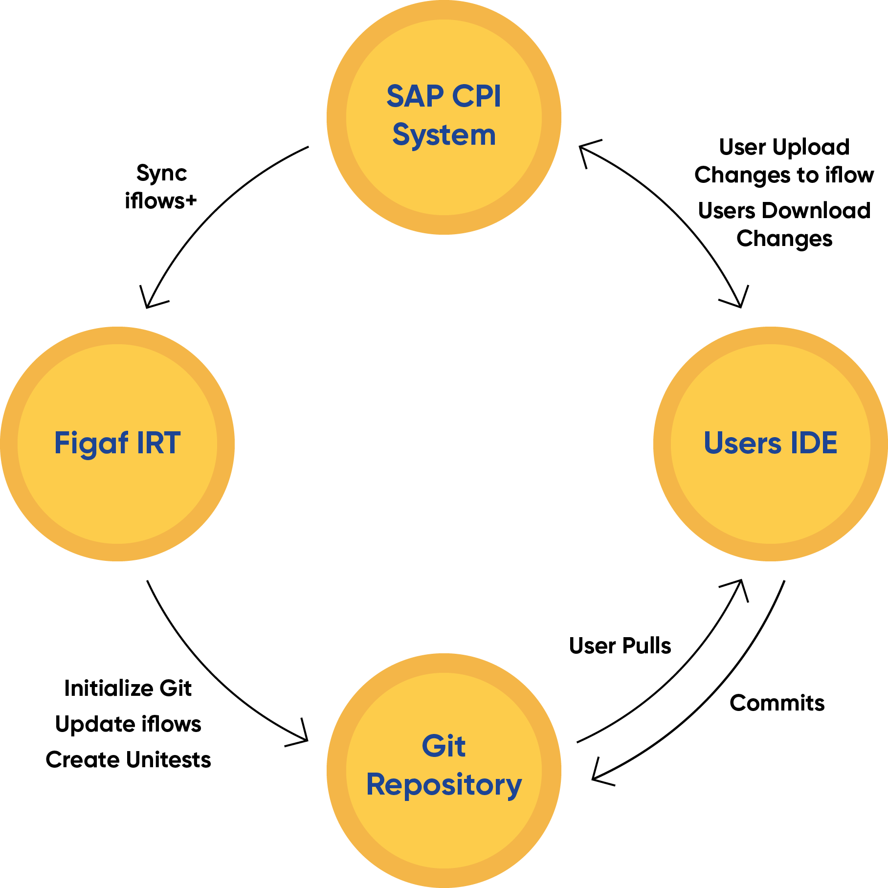
Git process
Git object is created by Figaf DevOps
  Provides templates
  Test cases
  Possible all IFlows
User can stay in Figaf branch or move to a different branch
SAP CPI: SAP Cloud Integration
© figaf 2022

Slide 14

Transports with Figaf Suite
With the Figaf Tool we have created a suite of products that handle the transport
Manage the transport
Handing the Testing of the change
Approval with full visibility
API managed Transports
Configuration of iFlows
Documentation
© figaf 2022

Slide 15
Transports of IFlows
Create transports with the packages, IFlows and value mappings in charge
Upload to virtual systems
(so you can save QA)
Approval of transports
  Different approvers in the process
  Configure if deployment needed
  Log of approvers
Configuration after upload
Testing the integration
Documentation of the ticket/change
Deployment
API if you want to invoke it from Azure, Jira or other platforms
© figaf 2022

Slide 16
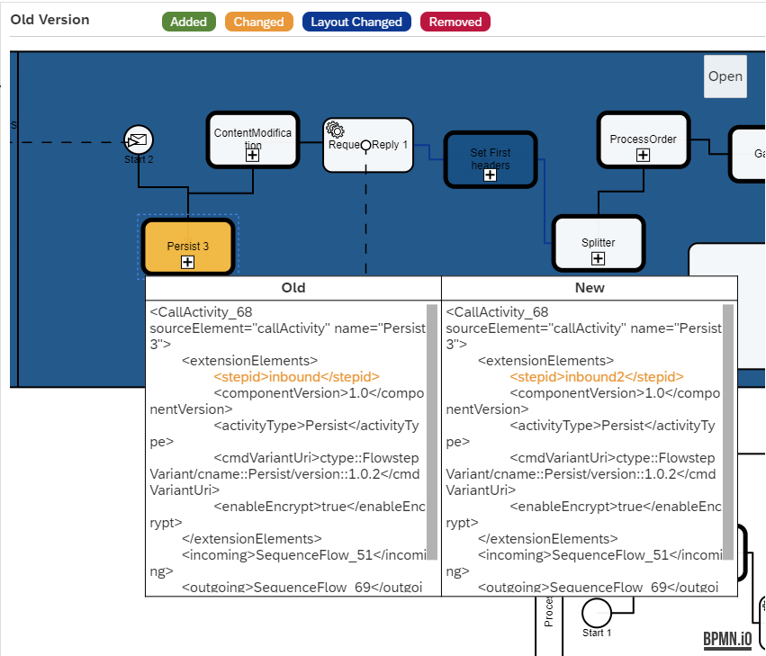
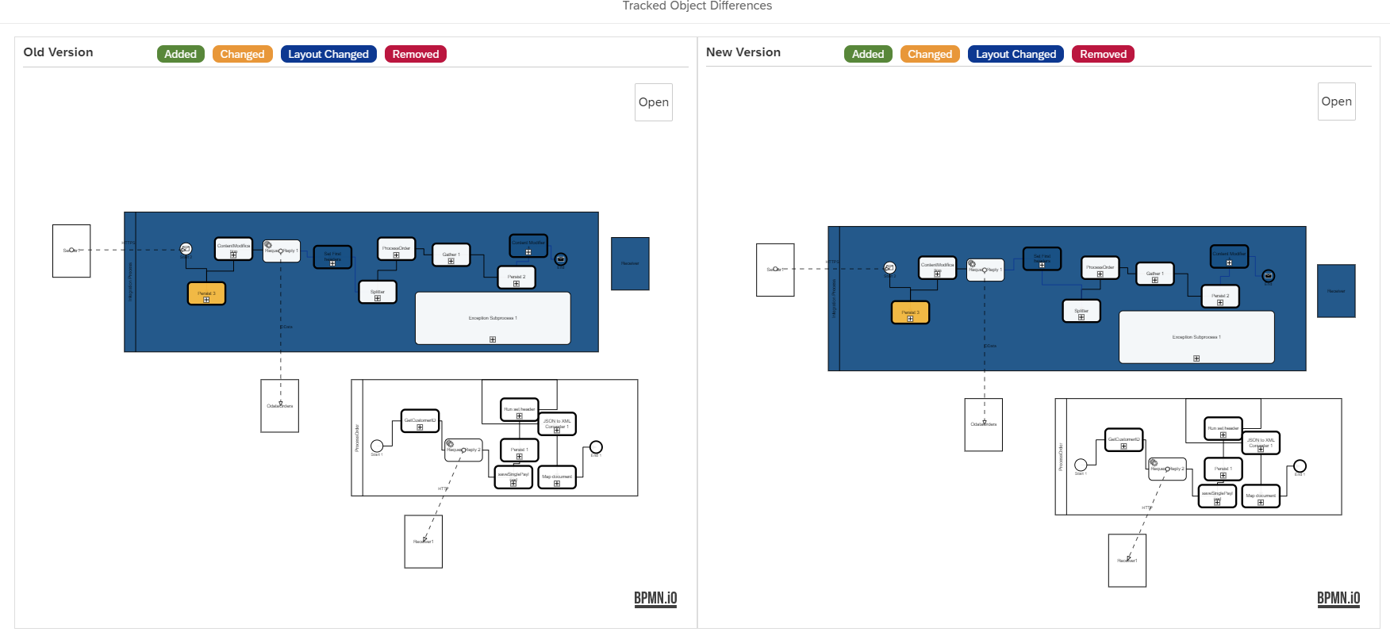
Visual BPMN diff tool
more views to compare objects
© figaf 2022

Slide 17
Binary landscapes
Enables you to transport between two systems
More options to handle configurations of the systems
Transports | Dev | QA | Production
1: Initial | IFlow1 v1 | IFlow1 v1
2: Changed | IFlow1 v2 | IFlow1 v2
3: Move to Prod |  | IFlow1 v2 | IFlow1 v2
4: Recondigere Prod |  | IFlow1 v2(config) | IFlow1 v2(config)

Slide 18
Virtual landscapes
What happens if you only have two tenants
Figaf can add pre/post fixes and let you handle transports like all
Process Direct will be processed in virtual landscape
Dev
QA
Prd
iflow1
qa_iflow1
iflow1

Slide 19
Supporting Script collection and Mappings
Improve the transport capabilities of existing objects
Track version of objects
Usage of artifacts in different iFlows
Transport of objects

Slide 20
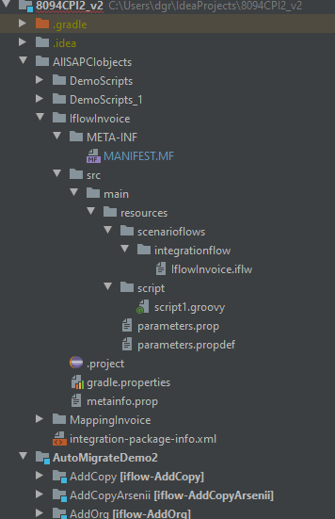
Git repository
Make it as simple as possible to setup
Gives you the opportunity to develop in IntelliJ or Eclipse
Comes with all the templates required for handling the development and testing
As easy as possible to make sure everybody can develop in a better UI
Always synchronized with latest content
Can add pipelines or actions to check the code

Slide 21
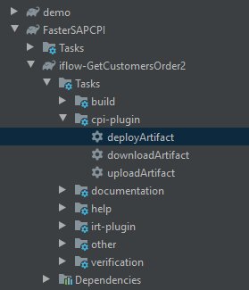
Gradle plugins
Speed up development so it is much easier to develop scripts
In your IDE you can now up and download artifacts
  Packages
  iFlows
  Script Collections
  Message Mappings
Makes it a lot easier to work with scripts and be able to test them
Run tests in Figaf

Slide 22
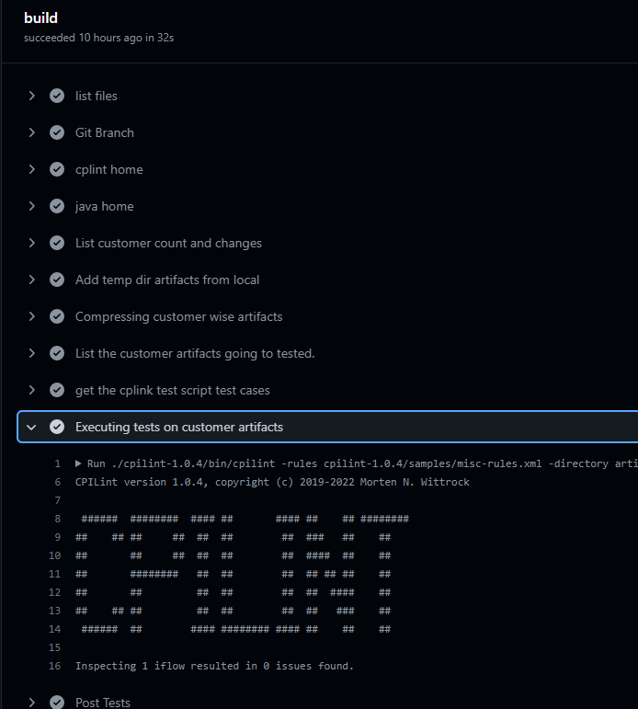
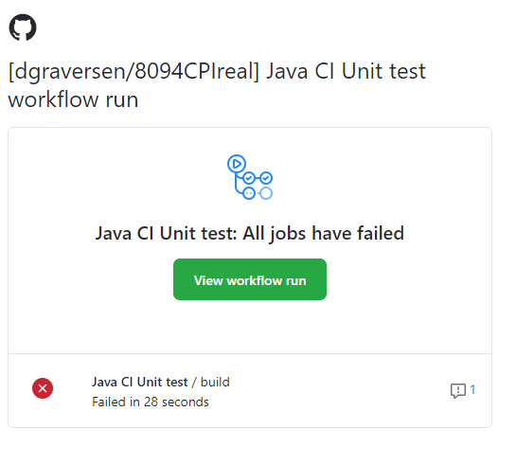
Git Pipelines/actions
Continues be able to check the status of integration to see if iflows follows guidelines
Example of Git action using CPILint
Each time an iflow is updated CPIlint is run on the iflow.
Code validations

Slide 23
Testing

Slide 24
Testing should
Part of the delivery process
Be easy or automatic to create test cases for all developers
Easy to execute so developers always run them
Updatable if the integration changes
Mock services if they cannot be used externally

Slide 25
Testing is also an important part of the process
Recording of test messages using the Trace process
Replaying by sending the same messages and check if everything is correct
Update the test case to ensuring the changes is acceptable
Can be integrated into other platform
© figaf 2022

Slide 26
Figaf CPI testing
Record Replay using Trace functionality
Easy recording of test cases
Enables developers to test integrations
Updateable test cases to make sure they are current
Mocking of external services, so processes will always run
Unit tests creation for Groovy

Slide 27
DevOps with Figaf for Cloud Integration

Slide 28
Business case
Time savings on transport
  Time savings pr transport performed 4-8 hours including testing, documentation and approvals
  Number of transports x Rate
  Example 4 transports x 6 hours x 70 EUR = 1.680 EUR
Other improvements
  Solve integrations faster
  Fewer errors and Faster resolution of errors
  Training time of employees/consultants
  Happier developers
Price starts at
  600 EUR/month + 300 for hosting in BTP

Slide 29
How long to create this yourself?
If you like working with git actions it is an interesting process
Will you get time to create a good process
Pipelines can be created to handle deployment etc
  Flexible to setup up
  It will require good scripting skills
Some testing can be performed with Postman, but not everything

Slide 30
General pricing
First 100 iflows 10.000 EUR/year (3 agents)
Extra 100 iflows 5.000 EUR/year
Extra agents (systems) 1.000 EUR/year

Slide 31
Implementation Plan
Meeting to understand how the tool can support your wish process
Trial evaluation tool
Installation on BTP Cloud Foundry
Configuration and setup of the landscape
Roll out of the tool
Time depends on your organization and scope.
We have seen times less than 1 month for productive use

Slide 32
Schedule a call
Create a call with your and your team
Understand the business case Figaf can help you with
Get a plan on how you can optimize your processes
Figaf.com/book

Slide 33
Free trial of Figaf
30 day free trial
Get to see how to use the tool follow some of our guides
Experiment yourself to get better processes
Figaf.com/devops

Slide 34
Q&A

Slide 35
Try it out
figaf.com/devops
© figaf 2022

