Slide 1
Automated Regression Testing
SAP Cloud Integration (CPI)

Slide 2
Agenda
Why do you want to test
Standard ways of testing
How to automate your testing
Testing your PI to CPI migration?
Everyday usage of your test cases
How to get started
© figaf 2022

Slide 3
Why test

Slide 4
What is regression testing
Have a standard process for test change, to ensure they does not change your integration

Slide 5
Last time I did not regression test
I was working on a project where we had a requirement to take Port of Loading from a new field
We did not have a set of test cases we could run
Unfortunately Port of Loading was not in data from both source systems
We did not have a clue about this problem until we where live and half the messages failed
We needed to figure out how to reprocess all the failed messages (they did not fail in the monitor). We probably spend 20 hours to resolve the situation + the business needed to wait 5 days with invoices

Slide 6
Why test
Avoid having problems current code
Cover the unexpected test cases that not all developers knows/remembers about
It is easier to resolve bugs before production because it is much simpler
© figaf 2022

Slide 7
Types of test
Assertions/Unittest:
If you know all cases and can insert assertions or unit test for specific cases
Record/replay:
If you want to process a number of document and see if they generate the same output

Slide 8
Standard testing options

Slide 9
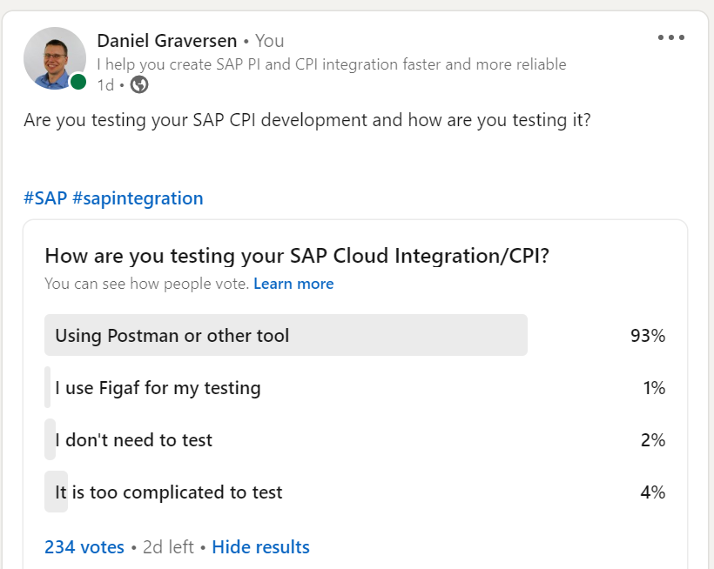
Linkedin Poll
Missing questions
Is it formalized testing or just adhoc while developing?
Postman is good while developing but not ideal as regression testing.

Slide 10
Postman / API
If you have build your iflows so they can be run with HTTP and a status back then it will be possible to test the iflows
You can setup assertions in the payload or connect to receiving systems to see the data is there
Limits
It will require a lot of effort setup and ensure they can always run
How do you test other protocols?
How do you test other data
Time consuming to create update

Slide 11
Groovy or XSLT
Create a set up unit test that developers can run to test code or XSLT
Requires:
A git repository where you have code that users can run
Good governance to ensure the scripts is maintained
Use some testing framework

Slide 12
Simulations (iFlows/Mappings)
CPI has the option to run simulations of iflows and message mappings. Here the developer inserts a payload and see if it is possible to run the test cases
Requires that you know how to check the output message if it is correct
You can have save files for each run
For larger payloads it can be challenging to spot problems

Slide 13
Automating your
CPI Tests

Slide 14
Record Test cases from iFlows
No modification required to the iflow
Should be simple from a user perspective
Create the test cases in a simple form
Configurable recording

Slide 15
Running Test cases
Select the test case and press run
Everything is automated to simplify the running
Comparison
Ignore know differences
Checking the status

Slide 16
Modifying test cases to test special conditions
You have a test case and want to make a modification to it to test something special
Create a copy using the test result
Make modifications to the payloads you want to test
Run the test and check the new processing

Slide 17
Mocking endpoints
Some scenarios needs to be mocked for instance
Create employee
Get order status between different systems
Figaf has one click mocking. The tool will handle all the setup and running of the test cases
How it works
Copy of original iflow
Replace all external endpoints to point to Figaf
Trigger iflow with link to test case
Figaf provides response to all queries
Fetch payload and compare

Slide 18
Unit tests scripts
It is possible to run unit tests for your Groovy scripts
No code required
Let developers see the impact of the code
Enable debugging of iflows
Gives better understanding what the impact of the change are

Slide 19
SAP PI to CPI migration testing

Slide 20
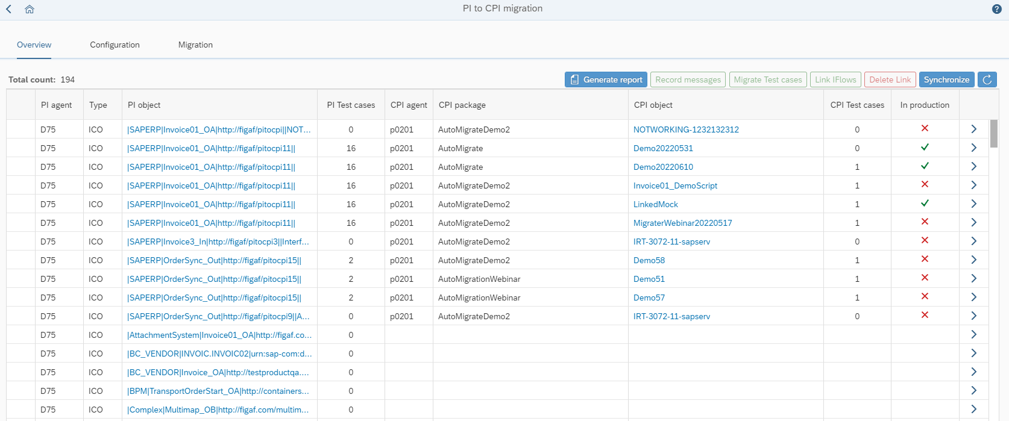
Testing PI to CPI migration
The tool will also enable you to test your migrated scenarios
Fetch test data from SAP PI
Convert it to SAP CPI test cases
Then process the documents and see the result

Slide 21
If you want more on PI to CPI migration
SAP PI to CPI objects
Convert message mappings with
  Function Libraries
  Parameters
  RFC lookup
Convert testing process
Figaf.com/PI-to-CPI

Slide 22
Everyday usage of testing

Slide 23
Testing should be used daily
Testing should be as normal approach as everything else in your life
Each change should be tested and test cases should be modified
There should not be an issue with knowing which test case that can run
Each transport should ideally be performed if there is a test case for it (lot easier with Figaf Tool)

Slide 24
Business case

Slide 25
Convincing management
I can show you the cool tool, but it will require work from your side to convince management about it
Which KPIs do you have for handling your integration?
Faster delivery of integration
Faster resolution of efforts
Fewer errors of first deployed iflows

Slide 26
Do it for yourself
You are here because you want to find a better way and the current ways bothers you
You want to spend more time on the fun and not the governance and testing
You want to deliver better quality

Slide 27
Business case for errors
How long does it take to resolve a bad message?
How often do something happen?
What is the cost to repair?
  Find and correct the error
  Labour cost
  Loss of order or reputation
What does it cost for your production to be offline for 1 hour?
Can be really hard to estimate

Slide 28
You can take action

Slide 29
Perform a Trial of the Tool
We have a self service trial that will allow you to set up and try the tool
You can either run Figaf on
  Your laptop
  SAP BTP Cloud Foundry
  Figaf Cloud for Trial
You can get started in one hour
figaf.com/devops

Slide 30
Schedule a call
Create a call with your and your team
Understand the business case Figaf can help you with
Get a plan on how you can optimize your processes
Figaf.com/book

Slide 31
QA

Slide 32
Try it out
figaf.com/devops
© figaf 2022

